Slide 1
Priyadarshini College of Engineering, Nagpur
Department of Computer Science and Engineering
Class: VII Sem
Subject : Cryptography and Network Security

Slide 2


Slide 3
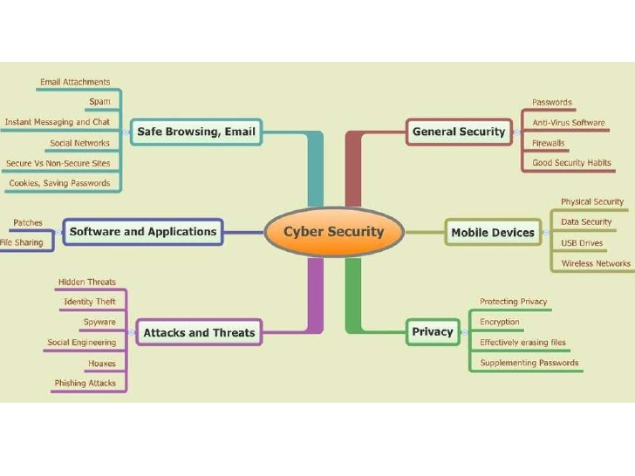

Slide 4


Slide 5
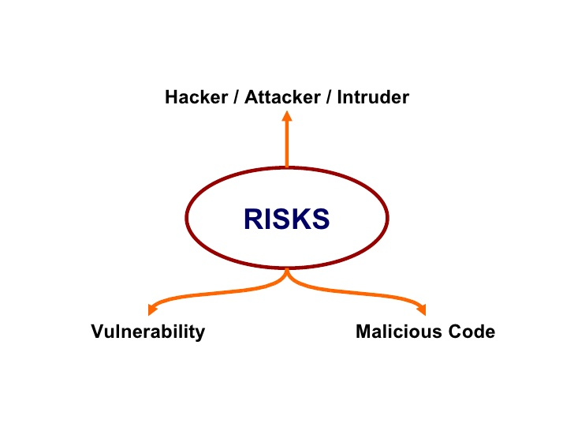

Slide 6


Slide 7
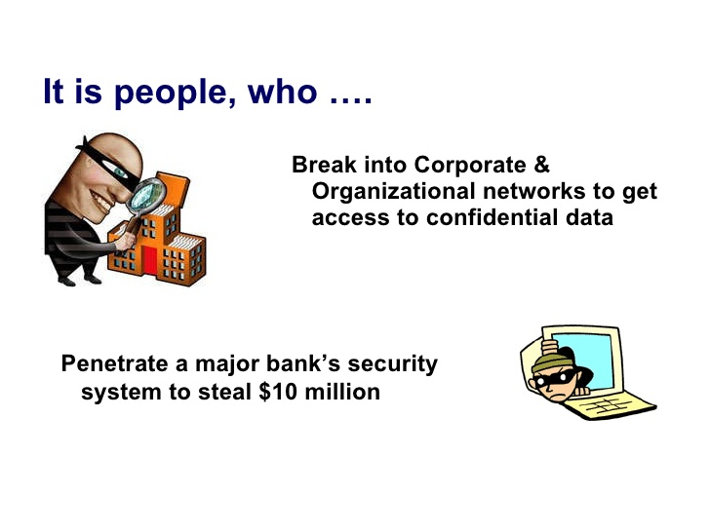

Slide 8
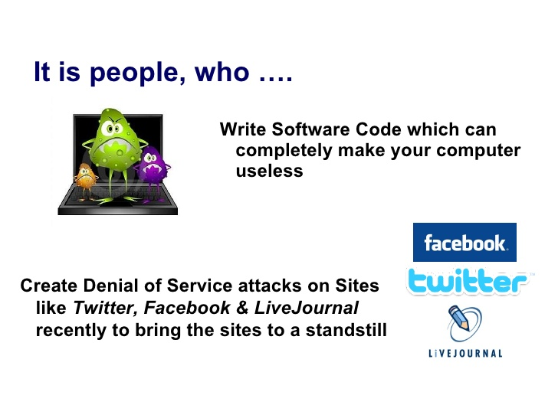

Slide 9


Slide 10
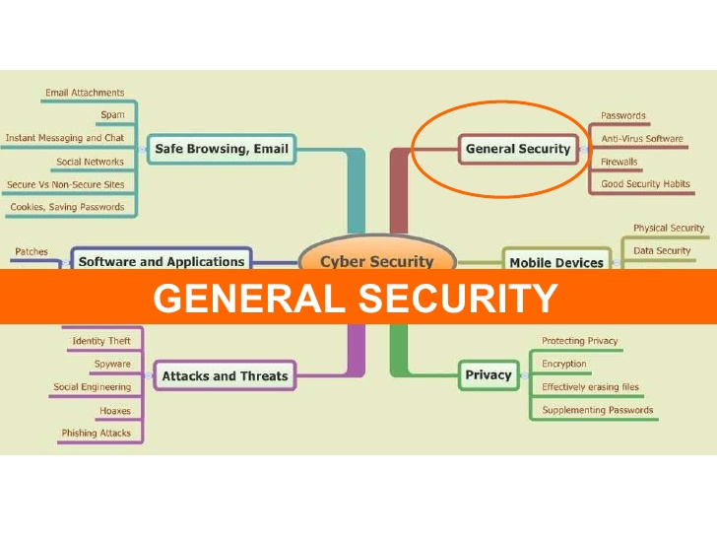

Slide 11
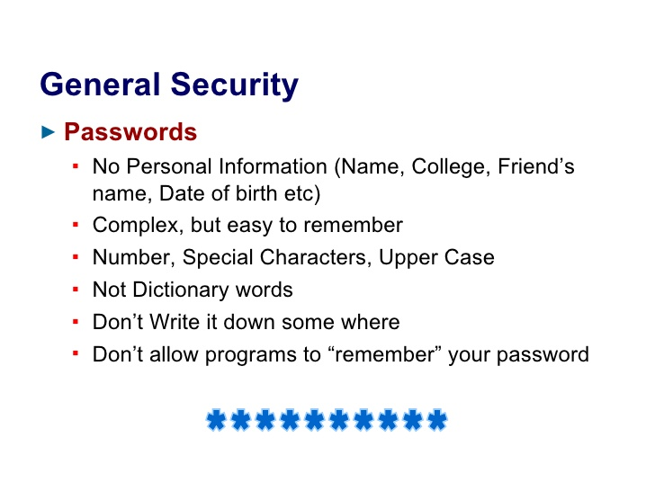

Slide 12
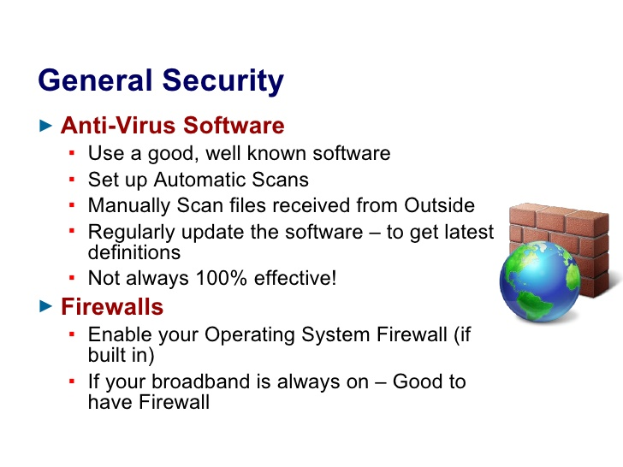

Slide 13
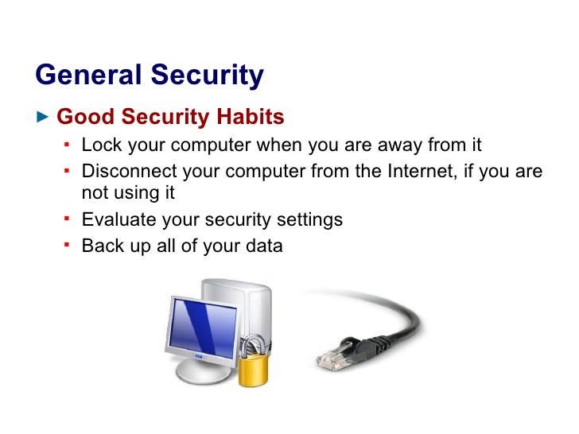

Slide 14


Slide 15
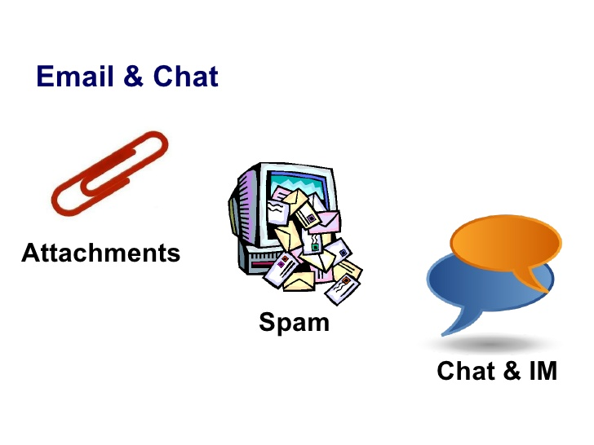

Slide 16
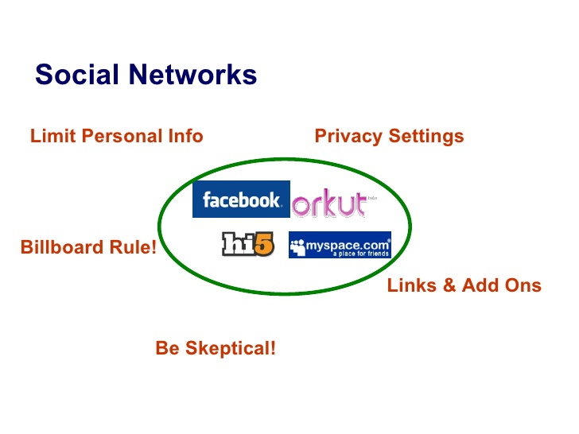

Slide 17
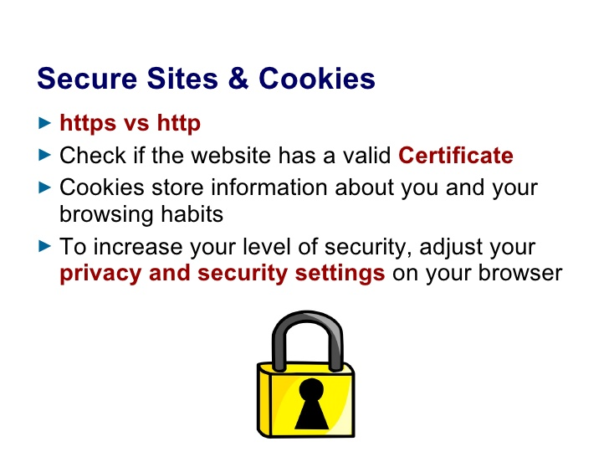

Slide 18
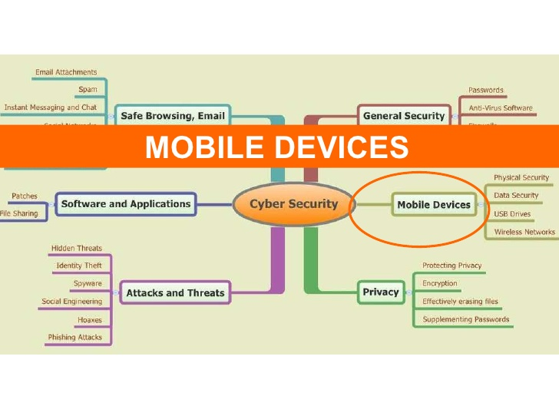

Slide 19
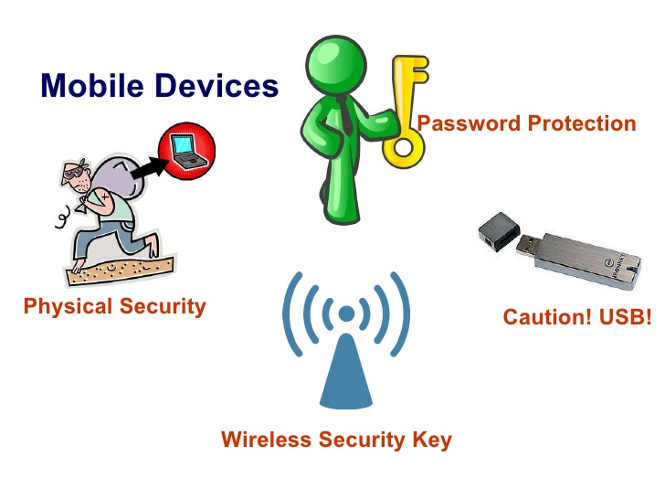

Slide 20


Slide 21
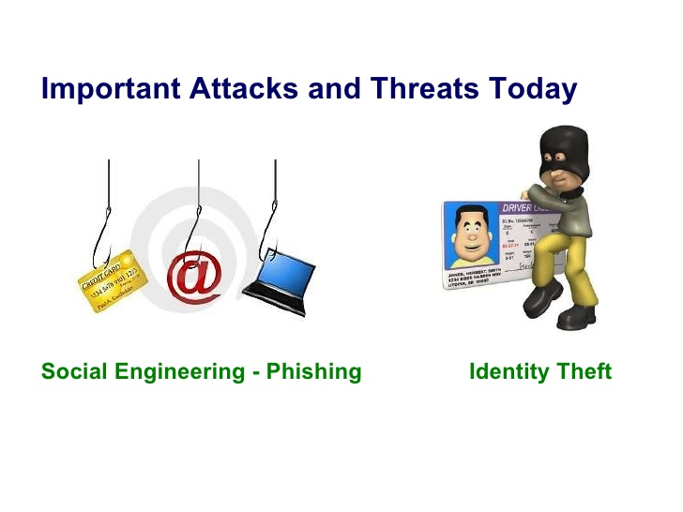

Slide 22
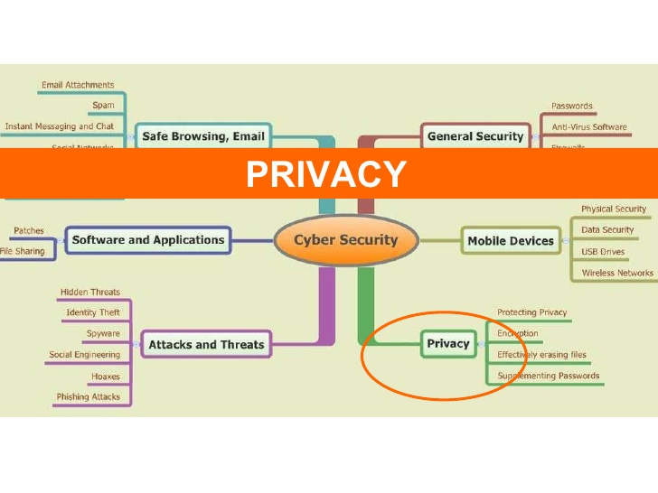

Slide 23
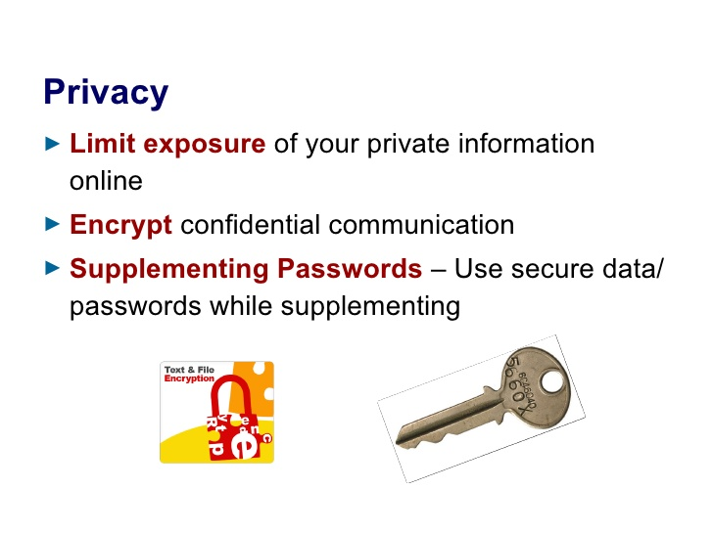

Slide 24
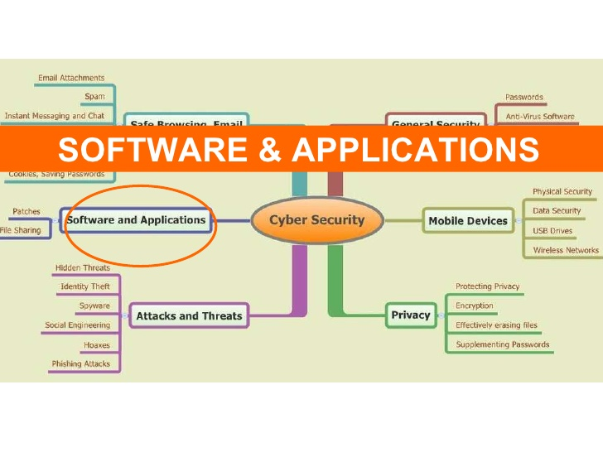

Slide 25


Slide 26
Contents
Need of Security
Principles of Security
Types of Attack
A model of Internetwork Security
Conventional Encryption
Substitution techniques

Slide 28
Security
Security can be defined as state of freedom from a danger, risk or attack.
Information security can be defined as the task of guarding information which is processed by a server, stored on a storage device, and transmitted over a network like Local Area Network or the public Internet.
Information security means protecting information and information systems from unauthorized access, use, disclosure, disruption, modification or destruction

Slide 29
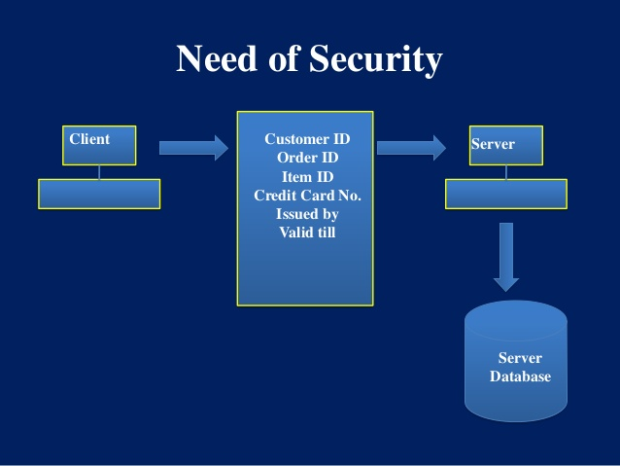

Slide 30
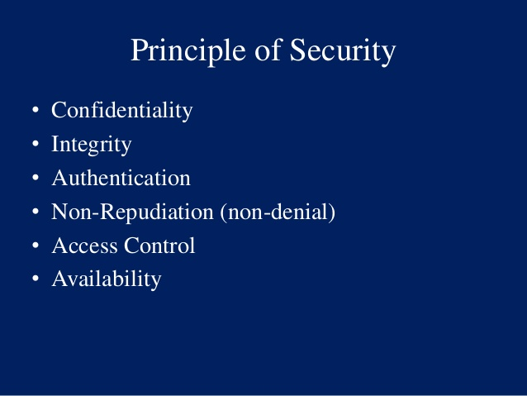

Slide 31
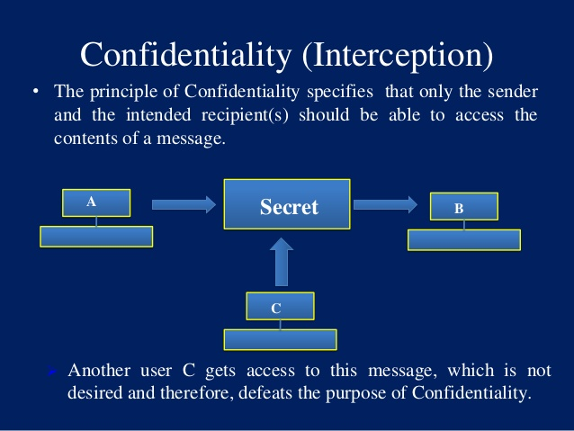

Slide 32
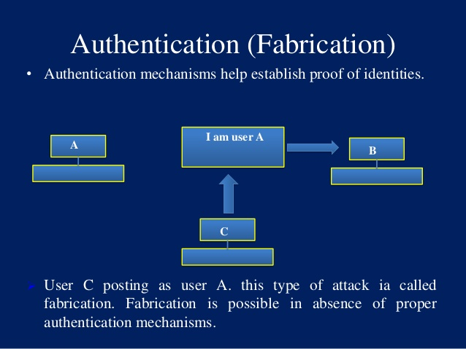

Slide 33
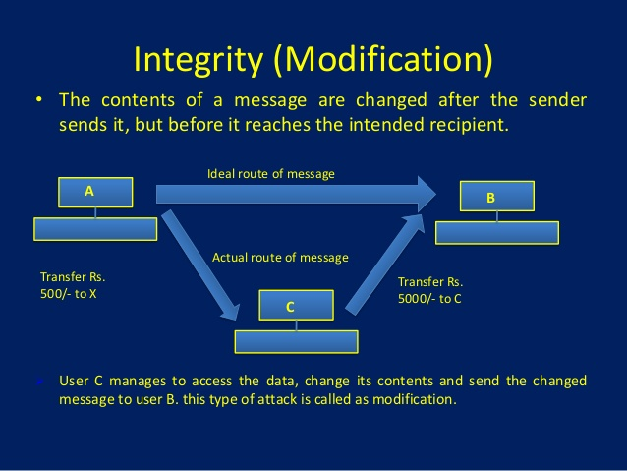

Slide 34
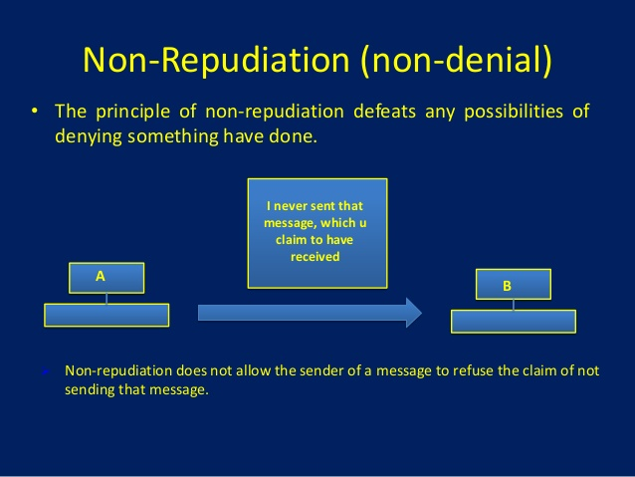

Slide 35
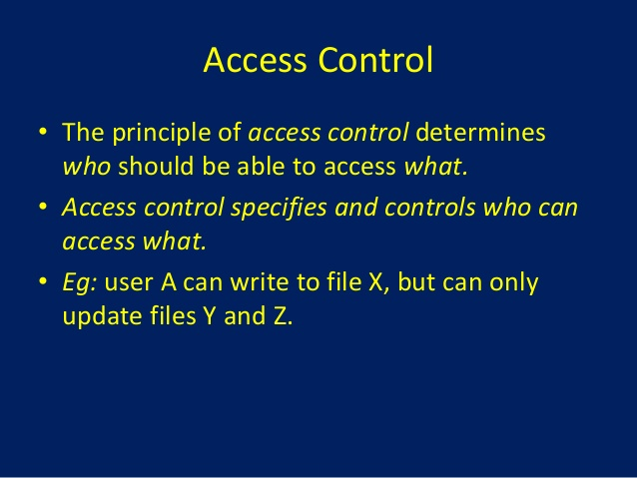

Slide 36
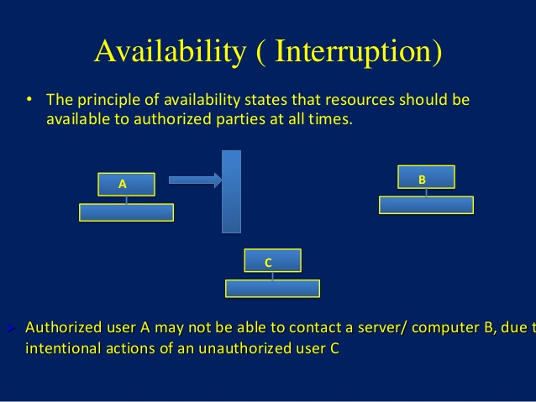

Slide 37
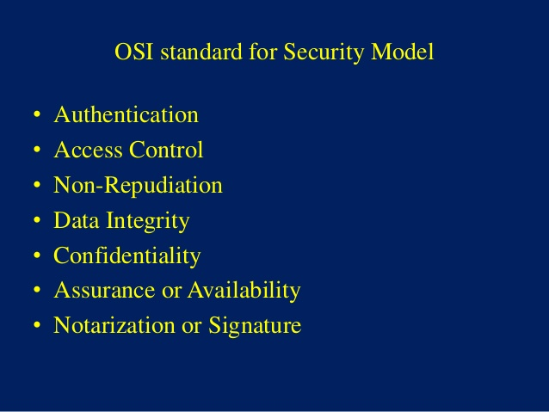

Slide 38
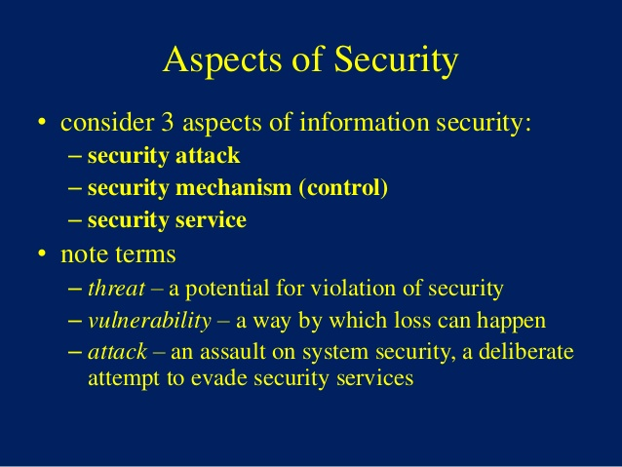

Slide 39
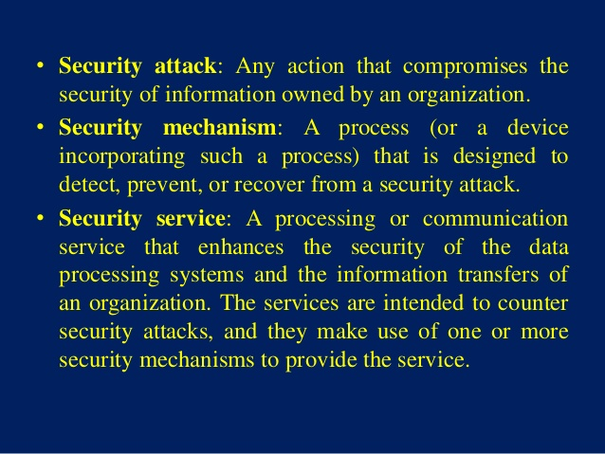

Slide 40
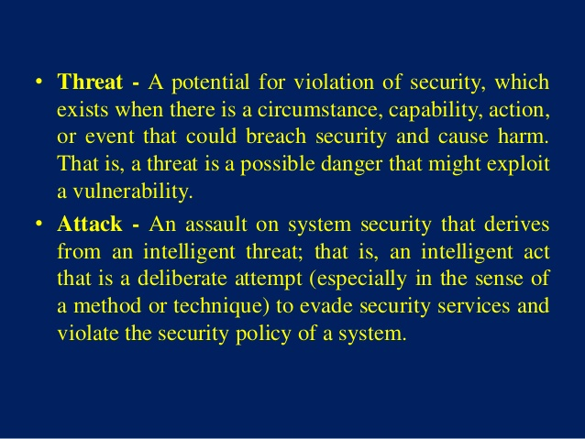

Slide 41
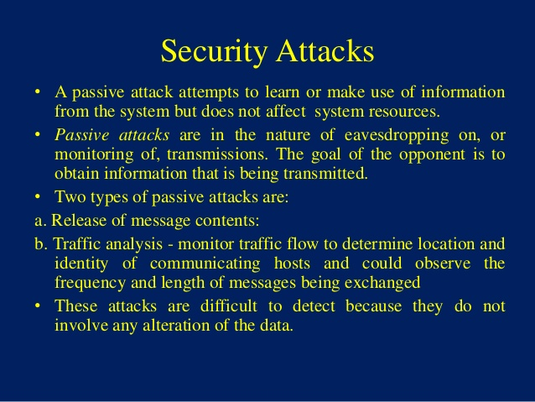

Slide 42
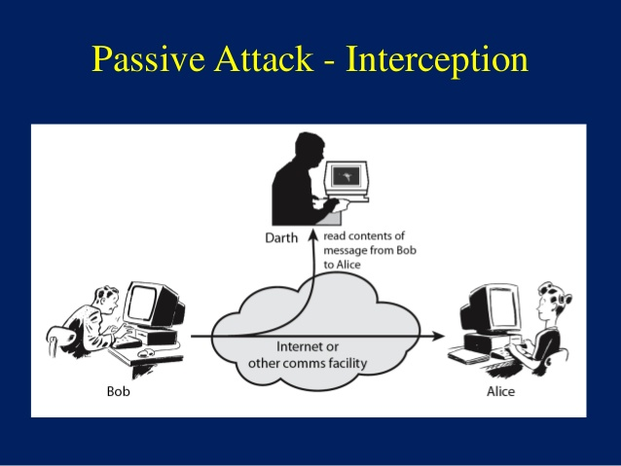

Slide 43
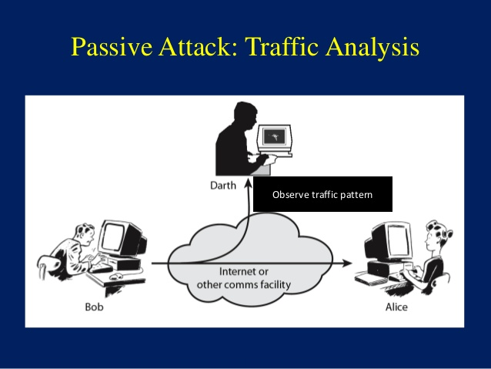

Slide 44
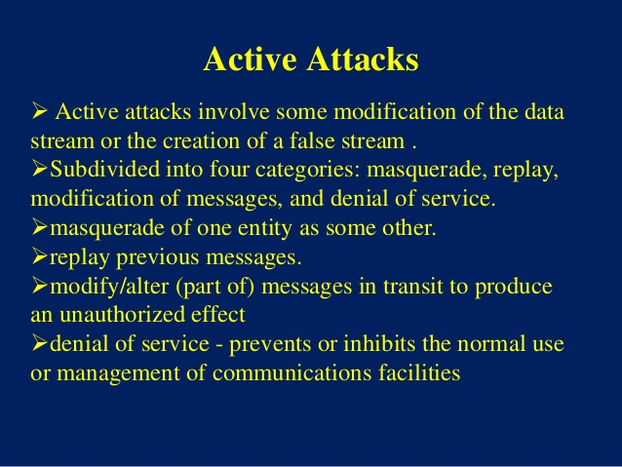

Slide 45
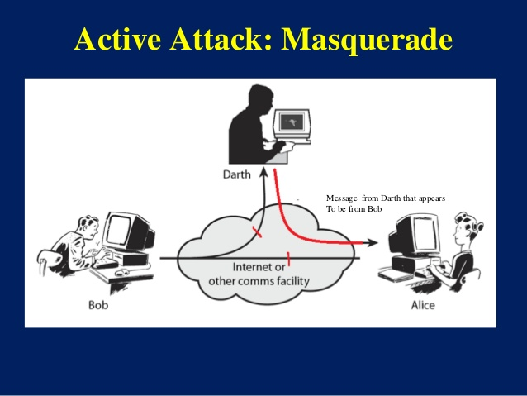

Slide 46
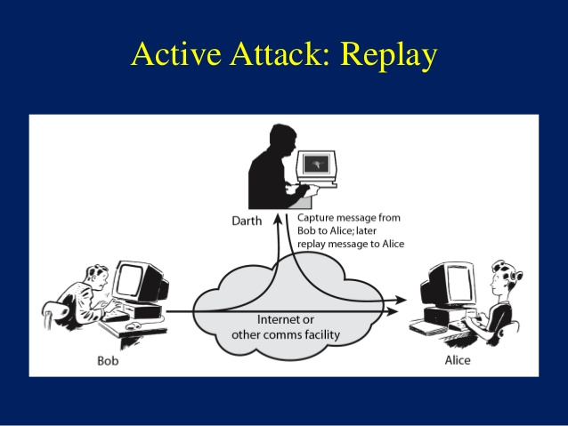

Slide 47
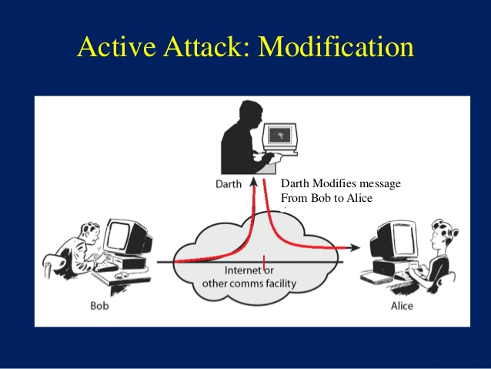

Slide 48
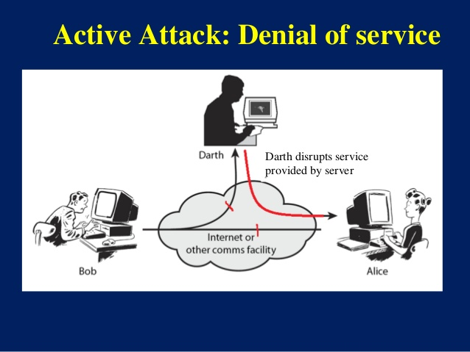

Slide 49
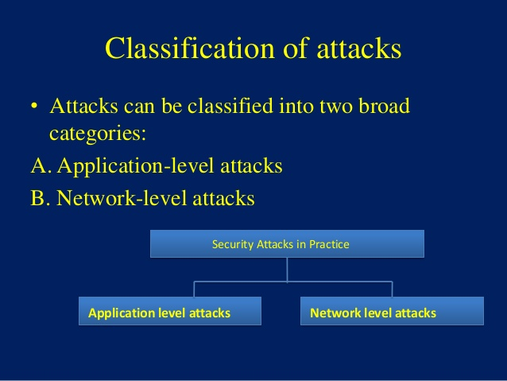

Slide 50
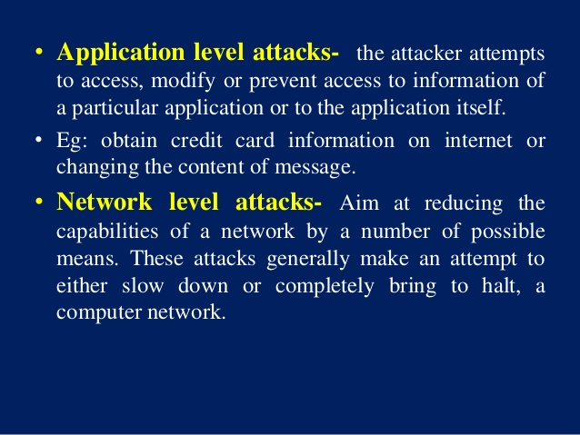

Slide 51
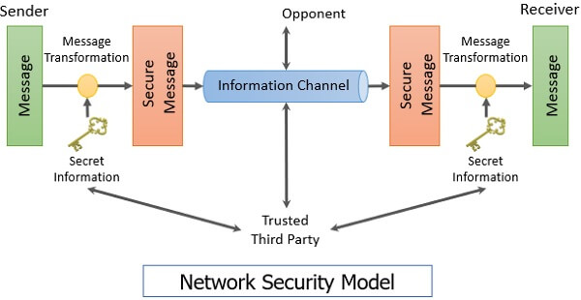
A model of Internetwork Security

Slide 52
A model of Internetwork Security
This model shows that there are four basic tasks in designing a particular security service:
Design an algorithm for performing the security-related transformation.
Generate the secret information to be used with the algorithm.
Develop methods for the distribution and sharing of secret information.
Specify a protocol to be used by the two principals that make use of the security algorithm and the secret information to achieve a particular security service.

Slide 53
Classical Encryption Techniques
The various classical encryption techniques are classified as:-
Symmetric encryption: It is a form of cryptosystem in which encryption and decryption are performed using the same key. It is also known as conventional encryption. ● Symmetric encryption transforms plaintext into ciphertext using a secret key and an encryption algorithm. Using the same key and a decryption algorithm, the plaintext is recovered from the ciphertext. The two types of attack on an encryption algorithm are cryptanalysis, based on properties of the encryption algorithm, and brute-force, which involves trying all possible keys.
Substitution techniques: Substitution techniques map plaintext elements (characters, bits) into ciphertext elements.
Transposition techniques :-systematically transpose the positions of plaintext elements.
Rotor machines : are sophisticated precomputer hardware devices that use substitution techniques.
Steganography is a technique for hiding a secret message within a larger one in such a way that others cannot discern the presence or contents of the hidden message.

Slide 54
Conventional Encryption
Symmetric encryption is also referred to as conventional encryption or single-key encryption.
It was the only type of encryption in use prior to the development of public-key encryption.
It remains by far the most widely used of the two types of encryption.

Slide 55
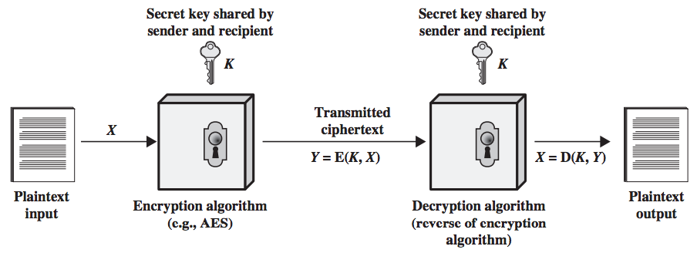
Fig 1 Simplified Model of Conventional Encryption

Slide 56
A symmetric encryption scheme has five ingredients:
Plain text: This is the Original intelligible message or data that is fed in to the algorithm as input.
Encryption Algorithm: The encryption algorithm performs various substitutions and transformation on the plain text to convert it into ciphertext.
Secret Key: The secret key is also input to the encryption algorithm. The key is a value independent of the plain text. The algorithm will produce a different output depending on the specific key being used at the time. The exact substitutions and transformations performed by the algorithm depend on the key.

Slide 57
4. Ciphertext: This is the scrambled message produced as output. It depends on the plain text and the secret key. For a given message, two different keys will produce different ciphertexts. The ciphertext is an apparently random stream of data and, as it stands, is unintelligible.
5. Decryption Algorithm: This is essentially the encryption algorithm run in reverse. It takes the ciphertext and the secret key as the input and produces the original plain text.

Slide 58
Two requirements for secure use of conventional encryption-
We need a strong encryption algorithm. The opponent should be unable to decrypt ciphertext or discover the key even if he or she is in possession of a number of ciphertext together with the plain text that produce each ciphertext.
Sender and Receiver must have obtained copies of the secret key in a secure fashion and must keep the key secure. If someone can discover the key and knows the algorithm, all information using this key is readable.

Slide 59
The important point is that the security of conventional encryption depends on the secrecy of the key, not the secrecy of the algorithm i.e. it is not necessary to keep the algorithm secret, but only the key is to be kept secret..

Slide 60
Cryptography
Cryptography is a method of protecting information and communications through the use of codes, so that only those for whom the information is intended can read and process it. Thus preventing unauthorized access to information.
The prefix "crypt-" means "hidden" -- and the suffix "-graphy" stands for "writing."

Slide 61
Techniques used For Cryptography:
Encryption: The process where an ordinary plain text is converted to cipher text which is the text made such that intended receiver of the text can only decode it and hence this process is known as encryption.
Decryption: The process of conversion of cipher text to plain text this is known as decryption.

Slide 62
Features Of Cryptography are :
1. Confidentiality:
Information can only be accessed by the person for whom it is intended and no other person except him can access it.
Integrity:
Information cannot be modified in storage or transition between sender and intended receiver without any addition to information being detected.
Non-repudiation:
The creator/sender of information cannot deny his or her intention to send information at later stage.
Authentication:
The identities of sender and receiver are confirmed. As well as destination/origin of information is confirmed.

Slide 63
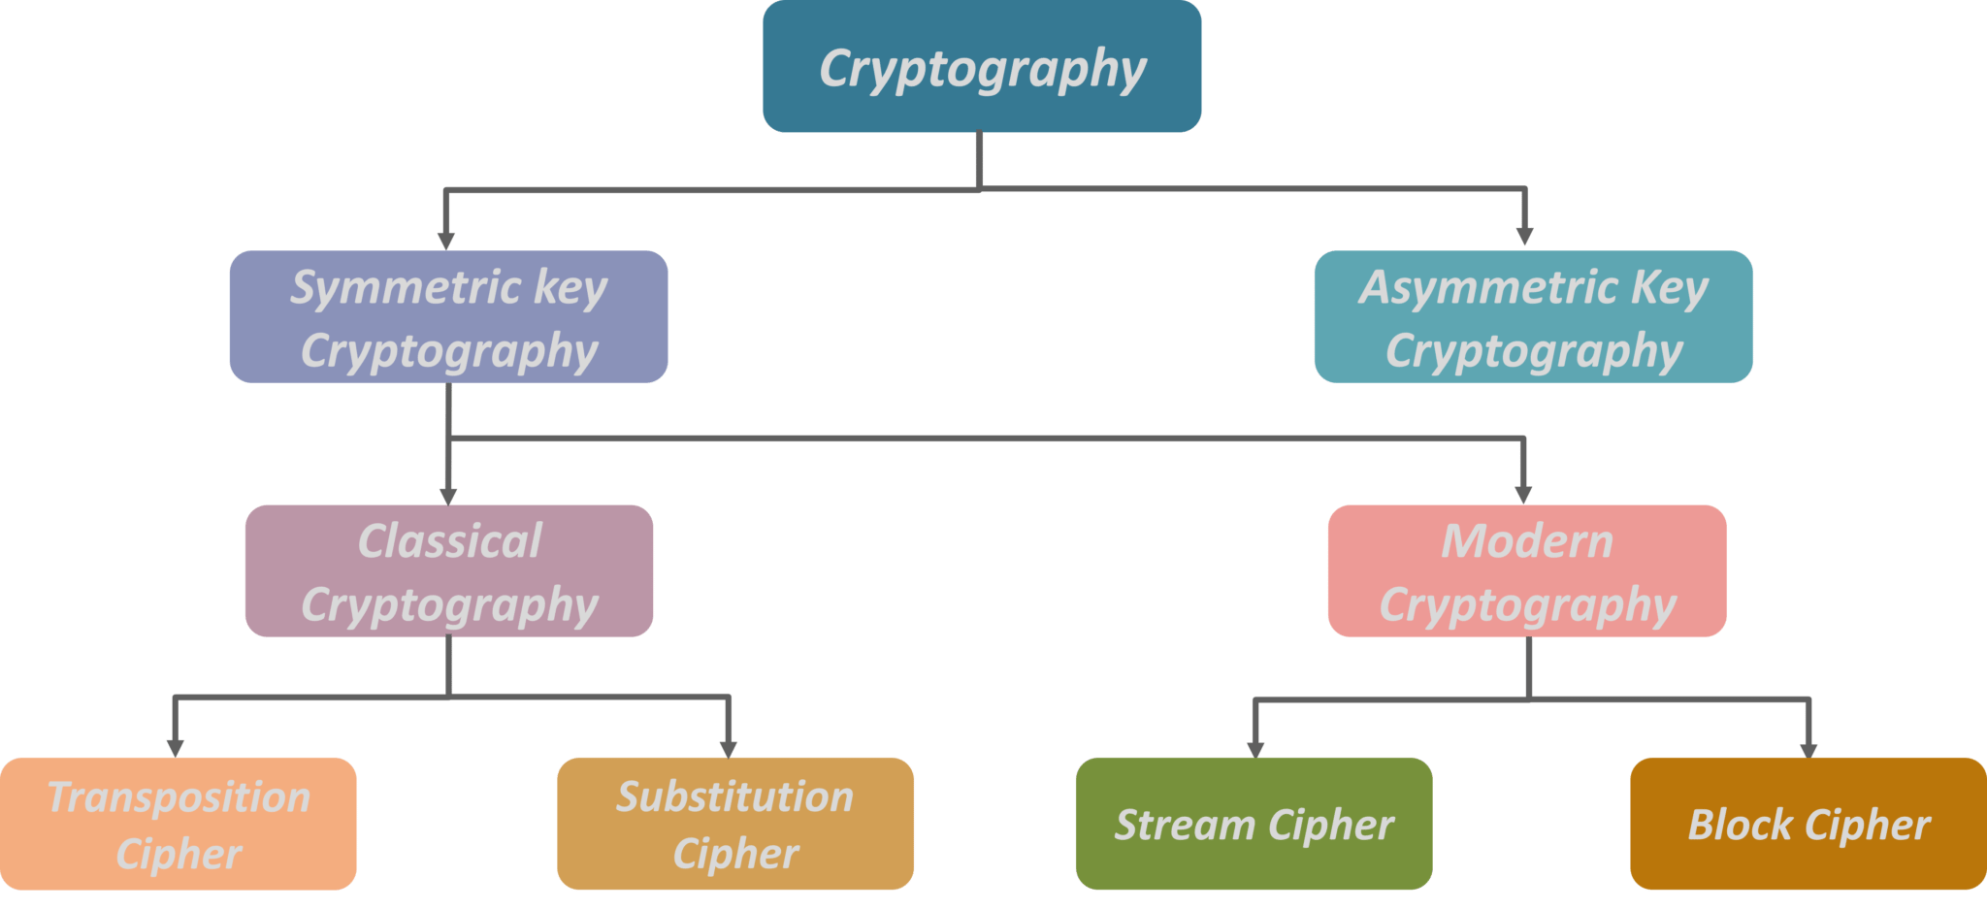
Types Of Cryptography:
Cryptography is broadly classified into two categories:
Symmetric key Cryptography and Asymmetric key Cryptography (popularly known as public key cryptography).

Slide 64
Symmetric Key Cryptography-
An encryption system in which the sender and receiver of a message share a single, common key that is used to encrypt and decrypt the message.
The most popular symmetric–key system is the Data Encryption Standard (DES)
Asymmetric Key Encryption (or Public Key Cryptography)
The encryption process where different keys are used for encrypting and decrypting the information.
Keys are different but are mathematically related, such that retrieving the plain text by decrypting ciphertext is feasible.
RSA(Rivest, Shamir, and Adelman) is the most widely used form of public key encryption.

Slide 65
Transposition Ciphers-
In Cryptography, a transposition cipher is a method of encryption by which the positions held by units of plaintext (which are commonly characters or groups of characters) are shifted according to a regular system, so that the ciphertext constitutes a permutation of the plaintext.
Substitution Cipher-
Method of encryption by which units of plaintext are replaced with ciphertext, according to a fixed system; the “units” may be single letters (the most common), pairs of letters, triplets of letters, mixtures of the above, and so forth.

Slide 66
Stream Cipher
Symmetric or secret-key encryption algorithm that encrypts a single bit at a time.
With a Stream Cipher, the same plaintext bit or byte will encrypt to a different bit or byte every time it is encrypted.
Block Cipher
An encryption method that applies a deterministic algorithm along with a symmetric key to encrypt a block of text, rather than encrypting one bit at a time as in stream ciphers.
A common block cipher, AES.

Slide 67
Cryptographic systems are classified along three independent dimensions:
The type of operations used for performing plaintext to ciphertext :- All the encryption algorithms make use of two general principles; substitution and transposition through which plaintext elements are rearranged. Important thing is that no information should be lost.
The number of keys used:- If single key is used by both sender and receiver, it is called symmetric, single-key, secret-key or conventional encryption. If sender and receiver each use a different key, then it is called asymmetric, two-key or public-key encryption.
The way in which plaintext is processed :-A block cipher process the input as blocks of elements and generated an output block for each input block. Stream cipher processes the input elements continuously, producing output one element at a time as it goes along.

Slide 68
SUBSTITUTION TECHNIQUES

Slide 69
Substitution Techniques-
A substitution technique is one in which the letters of plaintext are replaced by other letters or by numbers or symbols.
If the plaintext is viewed as a sequence of bits, then substitution involves replacing plaintext bit patterns with cipher text bit patterns.
Types of Substitution Techniques:-
Caesar cipher (or) shift cipher
Monoalphabetic cipher
Playfair cipher
Polyalphabetic ciphers( Vigenere cipher )
One Time Pad Cipher

Slide 70
1. Caesar cipher (or) shift cipher-
The earliest known use of a substitution cipher and the simplest was by Julius Caesar.
The Caesar cipher involves replacing each letter of the alphabet with the letter standing 3 places further down the alphabet.
The Caesar cipher shifts all the letters in a piece of text by a certain number of places.
The key for this cipher is a letter which represents the number of place for the shift.
So, for example, a key D means “shift 3 places” and a key M means “shift 12 places”.
Note that a key A means “do not shift” and a key Z can either mean “shift 25 places” or “shift one place backwards”.

Slide 71
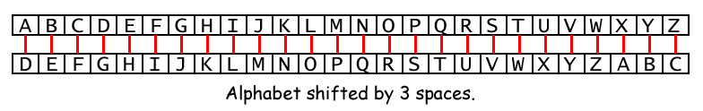
The number of spaces you shift is the key in the Caesar Cipher.
The example above shows the letter translations for the key 3.
If you encrypt the plaintext “Howdy” with a key of 3, then:
· The “H” becomes “K”.
· The letter “o” becomes “r”.
· The letter “w” becomes “z”.
· The letter “d” becomes “g”.
· The letter “y” becomes “b”.
The ciphertext of “Howdy” with key 3 becomes “Krzgb”.
To decrypt “Krzgb” with the key 3, we go from the bottom boxes back to the top:
· The letter “K” becomes “H”.
· The letter “r” becomes “o”.
· The letter “z” becomes “w”.
· The letter “g” becomes “d”.
· The letter “b” becomes “y”.

Slide 72
The encryption can also be represented using modular arithmetic by first transforming the letters into numbers, according to the scheme, A → 0, B → 1, ..., Z → 25.
Encryption of a letter x by a shift n can be described mathematically as,
E_{n} (x) = (x + n) mod 26
Decryption is performed similarly,
D_{n} (x) = (xi - n) mod 26

Slide 73
Caesar Cipher Weakness:
The major weakness of Caesar cipher is predictability.
Caesar Cipher is not very secure.
The cryptanalysis needs to be aware of only the points to break the cipher text message using the brute force attack.
There are only 25 possibilities to try out.

Slide 74
2. Monoalphabetic Substitution Cipher:
The weakness of Caesar's cipher is it’s predictability.
Instead of using a unique form for all alphabets in a plain text message use a random substitution.
Rather than just shifting the alphabet we could shuffle (jumble) the letters arbitrarily
Each plaintext letter maps to a different random cipher text letter hence key is 26 letters long

Slide 75
Monoalphabetic substitution cipher also known as simple substitution cipher, relies on a fixed replacement structure, i.e substitution is fixed for each letter of the alphabet.
A simple example is where each letter is encrypted as the next letter in the alphabet.
Example: “ a simple message” becomes “ B TJNQMF NFTTBHF”.
Each letter can be encrypted to any symbol [ &,%,?, /,*,{,}, @,+,-] not just another letter.

Slide 76
Disadvantage of Monoalphabetic Substitution Cipher
The major disadvantage is that by substituting more than one character of ciphertext for each plaintext value, the length of messages and resulting transmission times are increased.
A second disadvantage is that more training and discipline are required to take advantage of the increased security.

Slide 77
3. Playfair cipher
The Playfair cipher or Playfair square or Wheatstone–Playfair cipher is a manual symmetric encryption technique and was the first literal diagram substitution cipher.
The scheme was invented in 1854 by Charles Wheatstone, but bears the name of Lord Playfair for promoting its use.
The Playfair cipher uses a 5 by 5 table containing a key word or phrase. Memorization of the keyword and 4 simple rules was all that was required to create the 5 by 5 table and use the cipher.

Slide 78
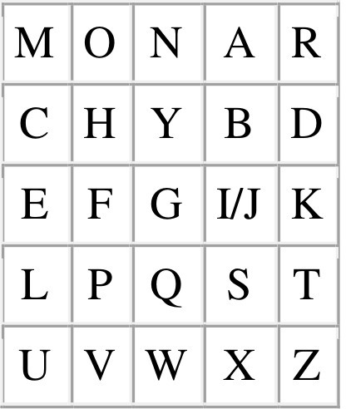
A keyword is "MONARCHY"
then the matrix will look like:
Plaintext is encrypted two letters at a time, according to the following rules:
Take the characters in the text(plain/cipher) and make a group of two characters. If the numbers of characters in the text is odd then add a filler letter (usually we use 'x'). Text="HELLO" then it would be group as HE | LL | OX
Two plaintext letters that fall in the same row of the matrix are each replaced by the letter to the right, with the first element of the row circularly following the last. For example, ar is encrypted as RM.
Two plaintext letters that fall in the same column are each replaced by the letter beneath, with the top element of the column circularly following the last. For example, mu is encrypted as CM.
Otherwise, each plaintext letter in a pair is replaced by the letter that lies in its own row and the column occupied by the other plaintext letter.
Thus, hs becomes BP and ea becomes IM (or JM, as the encipherer wishes).
The matrix is constructed by filling in the letters of the keyword (minus duplicates) from left to right and from top to bottom, and then filling in the remainder of the matrix with the remaining letters in alphabetic order.

Slide 79
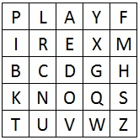
Example for Playfair cipher:
Que: Encrypt the plaintext "hide the gold in the tree stump" using the keyphrase playfair example.
Step:1:
Step: 2:
Step: 3: Apply the Rules
This becomes the Cipher Text.

Slide 80
Weakness of playfair cipher:
An interesting weakness is that repeated bigrams in the plaintext will create repeated bigrams in the ciphertext.
Further- more, a ciphertext bigram and its reverse will decipher to the same pattern in the plaintext.

Slide 81
4. Polyalphabetic cipher(Vignere Cipher)
Vigenere Cipher is a method of encrypting alphabetic text.
It uses a simple form of polyalphabetic substitution.
A polyalphabetic cipher is any cipher based on substitution, using multiple substitution alphabets. The encryption of the original text is done using the Vigenère square or Vigenère table.
The table consists of the alphabets written out 26 times in different rows, each alphabet shifted cyclically to the left compared to the previous alphabet, corresponding to the 26 possible.
At different points in the encryption process, the cipher uses a different alphabet from one of the rows.
The alphabet used at each point depends on a repeating keyword.

Slide 82
Vigenere Cipher is a method of encrypting alphabetic text. It uses a simple form of polyalphabetic substitution. A polyalphabetic cipher is any cipher based on substitution, using multiple substitution alphabets. The encryption of the original text is done using the Vigenère square or Vigenère table.
The table consists of the alphabets written out 26 times in different rows, each alphabet shifted cyclically to the left compared to the previous alphabet, corresponding to the 26 possible Caesar Ciphers.
At different points in the encryption process, the cipher uses a different alphabet from one of the rows.
The alphabet used at each point depends on a repeating keyword.

Slide 83
Example:
Input : Plaintext : G E E K S F O R G E E K S = 13
Keyword : A Y U S H A Y U S H A Y U = 13
Output : Ciphertext : G C Y C Z F M L Y L E I M =13
For generating key, the given keyword is repeated in a circular manner until it matches the length of the plain text.
The keyword "AYUSH" generates the key "AYUSHAYUSHAYU"
The plain text is then encrypted using the process explained below.

Slide 84
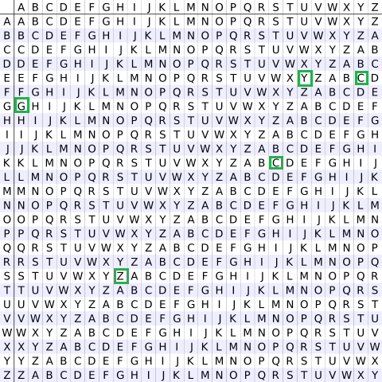
Encryption
The first letter of the plaintext, G is paired with A, the first letter of the key. So use row G and column A of the Vigenère square, namely G. Similarly, for the second letter of the plaintext, the second letter of the key is used, the letter at row E, and column Y is C. The rest of the plaintext is enciphered in a similar fashion.
Keyword
Table to encrypt
Plain Text

Slide 85
Decryption
Decryption is performed by going to the row in the table corresponding to the key, finding the position of the ciphertext letter in this row, and then using the column’s label as the plaintext. For example, in row A (from AYUSH), the ciphertext G appears in column G, which is the first plaintext letter. Next, we go to row Y (from AYUSH), locate the ciphertext C which is found in column E, thus E is the second plaintext letter.
Encryption
The plaintext(P) and key(K) are added modulo 26.
E_{i} = (P_{i} + K_{i}) mod 26
Decryption
D_{i} = (E_{i} - K_{i} + 26) mod 26

Slide 86
Monoalphabetic Cipher
A monoalphabetic cipher is any cipher in which the letters of the plain text are mapped to cipher text letters based on a single alphabetic key.
Examples of monoalphabetic ciphers would include the Caesar-shift cipher, where each letter is shifted based on a numeric key, and the atbash cipher, where each letter is mapped to the letter symmetric to it about the center of the alphabet.

Slide 87
A monoalphabetic substitution cipher, also known as a simple substitution cipher, relies on a fixed replacement structure.
Substitution is fixed for each letter of the alphabet. Thus, if "a" is encrypted to "R", then every time we see the letter "a" in the plaintext, we replace it with the letter "R" in the ciphertext.
A simple example is where each letter is encrypted as the next letter in the alphabet: "a simple message" becomes "B TJNQMF NFTTBHF".
For example

Slide 88
Difference Between Monoalphabetic Cipher and Polyalphabetic Cipher :
Sr. NO | Monoalphabetic Cipher | Polyalphabetic Cipher
1 | Monoalphabetic cipher is one where each symbol in plain text is mapped to a fixed symbol in cipher text. | Polyalphabetic cipher is any cipher based on substitution, using multiple substitution alphabets.
2 | The relationship between a character in the plain text and the characters in the cipher text is one-to-one. | The relationship between a character in the plain text and the characters in the cipher text is one-to-many.
3 | Each alphabetic character of plain text is mapped onto a unique alphabetic character of a cipher text. | Each alphabetic character of plain text can be mapped onto ‘m’ alphabetic characters of a cipher text.
4 | A stream cipher is a monoalphabetic cipher if the value of key does not depend on the position of the plain text character in the plain text stream. | A stream cipher is a polyalphabetic cipher if the value of key does depend on the position of the plain text character in the plain text stream.
5 | It includes additive, multiplicative, affine and monoalphabetic substitution cipher. | It includes autokey, Playfair, Vigenere, Hill, one-time pad, rotor, and Enigma cipher.
6 | It is a simple substitution cipher. | It is multiple substitutions cipher.
7 | Monoalphabetic Cipher is described as a substitution cipher in which the same fixed mappings from plain text to cipher letters across the entire text are used. | Polyalphabetic Cipher is described as substitution cipher in which plain text letters in different positions are enciphered using different cryptoalphabets.
8 | Monoalphabetic ciphers are not that strong as compared to polyalphabetic cipher. | Polyalphabetic ciphers are much stronger.

Slide 89
One time pad/ vernam cipher
Vernam Cipher is a method of encrypting alphabetic text. It is one of the techniques for converting a plain text into a cipher text. In this mechanism we assign a number to each character of the Plain-Text, like (a = 0, b = 1, c = 2, … z = 25).
Method to take key:
In Vernam cipher algorithm, we take a key to encrypt the plain text which length should be equal to the length of the plain text.
Encryption Algorithm:
Assign a number to each character of the plain-text and the key according to alphabetical order.
Add both the number (Corresponding plain-text character number and Key character number)
Subtract the number from 26 if the added number is greater than 26, if it isn’t then leave it. .

Slide 90
Example:
Plain-Text: RAMSWARUPK
Key: RANCHOBABA
Now according to encryption algorithm we assign a number to each character of our plain-text and key.
PT: R A M S W A R U P K
NO: 17 0 12 18 22 0 17 20 15 10
+
KEY: R A N C H O B A B A
NO: 17 0 13 2 7 14 1 0 1 0
= 34 0 25 20 29 14 18 20 16 10
= 8 0 25 20 3 14 18 20 16 10

Slide 91
Now add the number of Plain-Text and Key and after doing the addition and subtraction operation (if required), we will get the corresponding Cipher-Text character number.
CT-NO: 34 0 25 20 29 14 18 20 16 10
In this case, there are two numbers which are greater than the 26 so we have to subtract 26 from them and after applying the subtraction operation the new Cipher text character numbers are as follow:
CT-NO: 8 0 25 20 3 14 18 20 16 10
New Cipher-Text is after getting the corresponding character from the number.
CIPHER-TEXT: I A Z U D O S U Q K

Slide 92
Transposition Techniques
Transposition Techniques which includes
Rail-fence Technique,
Columnar Transposition,
Verman Cipher

Slide 93
Transposition Techniques are based on the permutation of the plain-text instead of substitution.
1) Rail-Fence Technique
This technique is a type of Transposition technique and write the plain text as a sequence of diagonals and changing the order according to each row.
It uses a simple algorithm,
Writing down the plain text message into a sequence of diagonals.
Row-wise writing the plain-text written from above step.

Slide 94
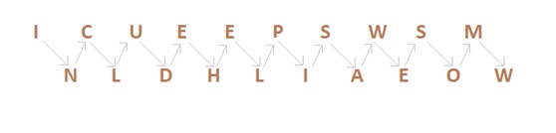
Example:
“INCLUDEHELP IS AWESOMW”.
So the Cipher-text are, ICUEEPSWSMNLDHLIAEOW.
First, we write the message in a zigzag manner then read it out direct row-wise to change it to cipher-text.
Now as we can see, Rail-Fence Technique is very easy to break by any cryptanalyst.

Slide 95
2) Columnar Transition Technique
A. Basic Technique
It is a slight variation to the Rail-fence technique, let’s see its algorithm:
In a rectangle of pre-defined size, write the plain-text message row by row.
Read the plain message in random order in a column-wise fashion. It can be any order such as 2, 1, 3 etc.
Thus Cipher-text is obtained.

Slide 96
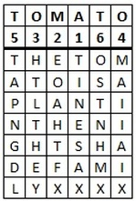
Encryption:-
We first pick a keyword for our encryption. We write the plaintext out in a grid where the number of columns is the number of letters in the keyword. We then title each column with the respective letter from the keyword. We take the letters in the keyword in alphabetical order, and read down the columns in this order. If a letter is repeated, we do the one that appears first, then the next and so on.
As an example, let's encrypt the message "The tomato is a plant in the nightshade family" using the keyword tomato. We get the grid given below.
We have written the keyword above the grid of the plaintext, and also the numbers telling us which order to read the columns in. Notice that the first "O" is 3 and the second "O" is 4, and the same thing for the two "T"s.
Starting with the column headed by "A", our ciphertext begins "TINESAX" from this column. We now move to the column headed by "M", and so on through the letters of the keyword in alphabetical order to get the ciphertext "TINESAX / EOAHTFX / HTLTHEY / MAIIAIX / TAPNGDL / OSTNHMX" .
The final ciphertext is thus "TINES AXEOA HTFXH TLTHE YMAII AIXTA PNGDL OSTNH MX".
The plaintext is written in a grid beneath the keyword. The numbers represent the alphabetical order of the keyword, and so the order in which the columns will be read.

Slide 97
THANK YOU !

